Slide 1

Ganapati
Team Name :
Gourav Singh
Team Leader Name :
Track 1: General Stablecoin Application
Problem Statement :

Slide 2
Brief about the Idea:
Our idea is that Real estate assets can be registered, transferred, and tokenized by users through a property dealing DApp on Cardano, which uses smart contracts to provide legally binding ownership records. Smooth real estate transactions are ensured by using Cardano stablecoins for escrow and payments, which also lessens dependency on middlemen.

Slide 3
Opportunity should be able to explain the following:
Difference -
Stop dealing with high costs and slow sales. Buy fractional ownership or partner to build properties worldwide, instantly from your phone. Our app gives you easy access and control to maximize your profits.
Solution to the Problem -
We smash the traditional barriers of real estate: High cost and Non-liquidity. Own fractional property and launch joint ventures globally directly from your phone, maximizing your ROI and building a powerful investment network within our DApp.
USP -
Fractionalize the world's real estate and launch joint development projects right from your mobile. Invest securely, connect globally, and earn high ROI with instant liquidity on our blockchain DApp.

Slide 4
List of features offered by the solution
1. Direct Fractional Ownership
2. Global Syndication
3. Mobile Command
4. Token Based
5. Incentivized Global Network

Slide 5
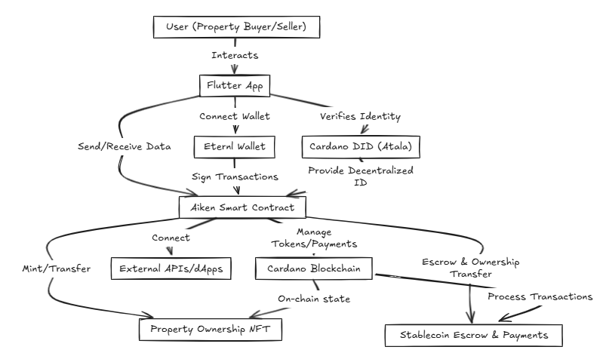
Process flow diagram or Use-case diagram

Slide 6
Wireframes/Mock diagrams of the proposed solution
[User / Mobile / Web]
│
▼
┌──────────────────────┐
│ Flutter Frontend App │ ← Flutter / Dart (Property Portal)
└──────────────────────┘
│ HTTPS / Eternl Wallet
▼
┌───────────────────────┐
│ API Gateway / │
│ Auth (JWT / DID / CIP)│
└───────────────────────┘
│
┌─────┴─────┐
│ │
▼ ▼
┌───────────────┐ ┌────────────────────┐
│ Asset Manager │ │ Off-chain Workers │
│ (Property Reg)│ │ (Event Bus, Broker)│
└───────────────┘ └────────────────────┘
│ │ │
│ └─────┐ │
│ ▼ ▼
│ ┌─────────────┐ ┌─────────────────────┐
│ │Oracle APIs │ │External Services │
│ │(Valuation, │ │(DeFi, DAO, Payments)│
│ │KYC, Legals) │ └─────────────────────┘
│ └─────────────┘
│ │
▼ │
┌───────────────────┐
│ Secure Storage / │
│ Metadata (IPFS) │
└───────────────────┘
│
▼
┌─────────────────────────┐
│ Cardano Smart Contract │
│ (Aiken / Plutus, Stable │
│ Coin Escrow, NFT Mint) │
└─────────────────────────┘
│
▼
┌────────────────────────╖─┐
│On-chain Records / │
│Property Ledger (UTxO) │
└─────────────────────────┘

Slide 7
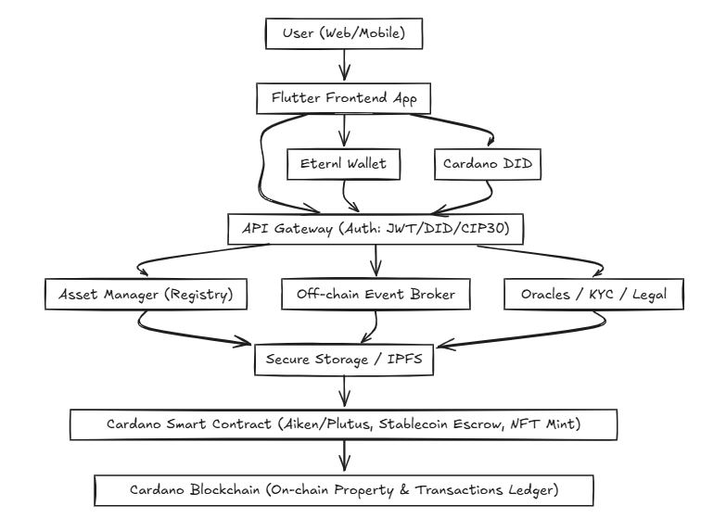
Architecture diagram of the proposed solution

Slide 8
Technologies to be used in the solution:
Frontend & User Interface –
Flutter: For cross-platform mobile and web app development (Dart language).
Wallet & Authentication -
Eternl Wallet: Cardano browser wallet with CIP-30 integration for DApp connections.​
Cardano DID (Atala PRISM or other DID method): For decentralized identity and verifiable credentials
Smart Contracts & Blockchain Integration -
Aiken: Modern Cardano smart contract language for writing robust, auditable smart contracts.
Property/Asset Tokens -
NFT Standards: Cardano NFT minting for representing property titles and deeds.

Slide 9
Estimated implementation cost (optional):
1. Blockchain Core - 35-40%
2. Mobile DApp - 20-25%
3. Legal & Security - 20-25%
4. Back-End & Buffer - 15-20%
Total Est =- 1Cr - 2.3Cr

Slide 10
Add as per the requirements for the hackathon:
High Speed Internet.
Charging port or Socket.
Seating place for the Team(3-4)

Slide 11


